Slide 1
Reading Data & Creating Datasets
Business Intelligence Systems and Data Mining IMAT5168 Analytics Programming

Slide 2

SAS data sets
A data set is a 2 dimensional table of rows and columns.
Each row represents data about one subject.
Each column is a ‘variable’ that stores a measurable feature of the subject.
There may be one or more rows per subject.
One or more columns may be repeated to record the same measurement many times
pulse_rate1, pulse_rate2, pulse_rate3
represents pulse rates taken at 5, 15 & 30 minutes after arriving at a GP
For database aficionados only…
The data are not normalised.

Slide 3
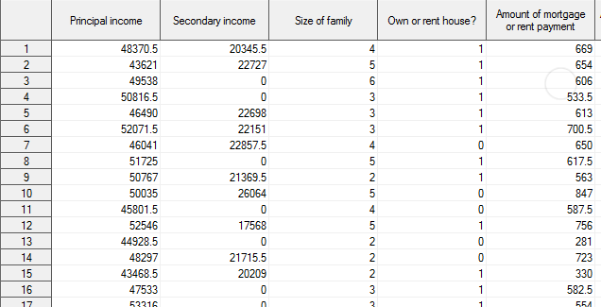
SAS Data Set Example

Slide 4
Anatomy of a SAS variable
Length
Size in characters
Data type
Numeric or text
Informat
The informat determines how data being input will be interpreted.
Outformat
The outformat determines how the variable will be formatted when printed in output.
Name (to use in code)
This is the name programs will use to refer the variable.
Label
This is the name for the variable’s column/axis to be used in tables or graphs.

Slide 5
Taxonomy of variables
 | Text ($) | Numeric
Nominal | Categories coded as text Convert to a number? | Categories coded as numbers (+1 has no meaning)
Ordinal | Ordered categories Convert to a number? | Ordered categories coded as numbers (World ranking) (+1 has no meaning)
Interval | Not applicable | Numbers where only add & subtract valid (Date) +1 has a meaning, 0 has no meaning
Ratio | Not applicable | Numbers where add, subtract, multiply & divide valid +1 has a meaning, 0 has meaning
Representation of missing values in SAS
Text: ''
two single quotes
Numbers: .
dot/period
Dates are treated as numeric data
Each date is the number of days after 1/1/1960

Slide 6
Data step processing overview
Compile phase
Declare space to store the line of data from the input file
Input buffer
Declare space for the required SAS variables
Program data vector
Initialise useful information about the process
Execution phase
Write the current variables to the data set
Reset all variables to missing
Build the next observation
read a line of data
use input statements to translate the text into a SAS variable
use data step programming statements to alter/add to SAS variables

Slide 7
Anatomy of the data statement
Each data step will contain data and source; the remaining elements will depend on the task.
data <output data set>;
source
set <input another SAS data set>;
infile <input a raw data file>;
length
length <lengths of variables>;
format
informat <informat definitions for variables>;
variables
input <variables>;
programming statements
if <condition> then <action>;
output <output the current set of variables>
output formatting
format <outformat definitions for variables>;
label <labels>;
data
datalines <data>;
run;

Slide 8
Strategy for data statements
Look at the source data
What format is it in?
Which input statements will help?
Identify any rows that are obviously unusual
Put them and one “standard” row in a test file or a datalines statement
Write the data statement to read the test data
ALWAYS look at the log
Check that the right number of records have been read
If there is an error, refine the data statement
Always view the data set itself
If the data are incorrect, refine the data statement
When the data statement is correct
Read the full dataset
Check the log for errors
Use univariate stats (continuous) or frequencies (categorical) to check data

Slide 9
About data in text files
Terminology
‘Delimiter’ is used for two purposes
It is used to mean:
Separator: (which SAS calls a delimiter)
the character(s) that separate data items
23 24 25 … /* a space character separates each number */
Delimiter: (for which SAS has no specific name)
the character(s) that surround the character(s) representing a data item
'Hello, World!' /* the quote (") delimits text */

Slide 10
Types of input
Column input General form: V[V]
123456789+123456789+ V = value
1 Smith 196412081 V₁= name 1-8, V₂ = Year 9-12
2 Williams197311075 V₃= SBP 13-15, V₄ = DBP 16-17
List input General form: DVDS[DVDS]
D = delimiter ("), V = value, S = separator (,)
1 "Smith", 1964, 120, 80
2 "Jones", 1973, 110, 75
Free formatted input General form: [hvs]V[[hvs]V]
V = value [hvs] = horizontal or vertical space
1 Smith
2 1964 120 80
3 Jones
4 1973 110 75
123456789+123456789+1234
123456789+123456789+

Slide 11
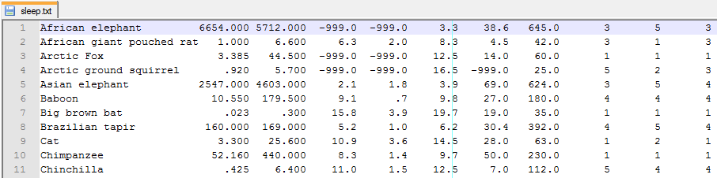
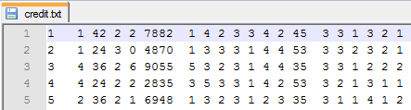
Data arranged in columns

Slide 12
Data step for columnar data
data customer;
infile
'credit.txt'
missover
;
input
customer 1-3 /* ID Number */
account 5 /* Chequing account */
duration 7-8 /* Duration in months */
history 10 /* Credit history */
/* more variable definitions here */
;
run;

Slide 13
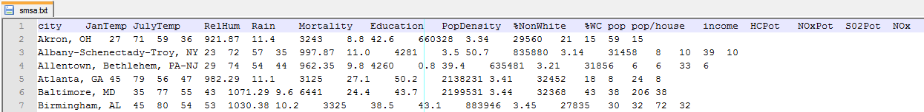
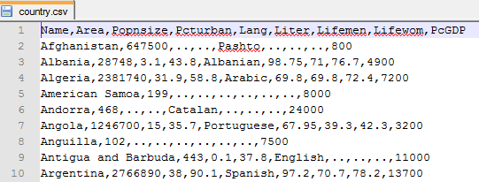
Data arranged in lists

Slide 14
List data example
data work.NewSalesEmps;
infile
'newemps.txt’
;
input
First_Name $ /* text */
Last_Name $
Job_Title & $ /* text with spaces */
Salary /* numeric */
;
run;

Slide 15
List data problems
Comma delimited
Commas in text variables
e.g. 323, "George Bush, Jnr", 44.50
Handle by adding DSD to INFILE command
NB: add DLM='09'x to use tab as a delimiter
Space delimited
Spaces in text variables (George Bush, Jnr)
e.g. 323 George Bush, Jnr 44.50
Handle by using ‘&’ before ‘$’ so that 2 spaces end input
Note: You may need to reformat the data to ensure 2 spaces are between data items.

Slide 16

Input from Excel in 32-bit Office
Problem: 64-bit SAS 9.4
cannot rad Excel or Access files directly if you are using 32-bit Microsoft Office
Solution:
Install SAS PC Files Server
See http://support.sas.com/kb/43/802.html
Import the data using: File -> Import data…
Try: “Microsoft Excel Workbook on PC Files Server”
Or: XLS or XLSX format
Save the program that SAS creates for later re-use.
Note:
Importing Excel files is not easy and requires a bit of patience and experimentation!

Slide 17

Data step for free format data
data club;
length
name $ 20
;
input
/* line pos variable format */
#2 @1 team $ 6.
#1 @6 name & $
@1 id
#3 @1 (wt0-wt1) (3.)
;
datalines;
/* data: 3 lines per subject */
1023 David Shaw
red
189 165
1049 Amelia Serrano
yellow
145 124
;
run;

Slide 18
Data step for free format data
Handle using cursor movement commands
@n set starting position
+n move n characters forward
/ new line
#n read from line n
n1-n2 read from position n1 to position n2

Slide 19
Input buffer underflow
Underflow: less data than used by all variables
flowover (default)
read next record & continue inputting variables
missover
set current variable to missing
start a new data step iteration with a new record
truncover
set current variable using available characters
start a new data step with a new record
stopover
stop data step processing

Slide 20
Strategies for: hierarchical input Multiple data subjects in input buffer
Hierarchical input strategy
Read variable using the input statement
@ = hold the data in the input buffer
use variables to decide how to proceed
then continue with the next input statement
Multiple data subjects in input buffer strategy
@@ = hold the data in the input buffer
then continue processing at the start of the data statement
See examples on next slides

Slide 21
Hierarchical input: Select subsets of the data, using @
data red_team;
input Team $ 13-18 @; /* hold the data */
if Team='red'; /* Sub-setting if statement */
/* only continue if condition true */
input /* code only reached if Team='red’ */
IdNumber 1-4
StartWeight 20-22
EndWeight 24-26;
datalines;
/*--+----+----+----+----+-*/
1023 David red 189 165
1049 Amelia yellow 145 124
*...;

Slide 22
Code to handle multiple data rows on one input line
data amess1978;
input
ventilation
folate
@@ /* more data on the same line */
;
datalines;
1 243 2 206 3 241
1 251 2 210 3 258
1 275 2 226 3 270
1 291 2 249 3 293
1 347 2 255 3 328
1 354 2 273
1 380 2 285
1 392 2 295
2 309
;
run;

Slide 23
Example informat
proc format;
invalue team
'red' = 0
'yellow' = 1
'green' = 2
'blue' = 3
other = .
;
run;

Slide 24
Using put to check…
Specific solution
General solution
input
. . .
team team6.
. . .
;
put 'team = ' team;
Log entries...
team = 0
team = 3
team = 2
team = 1
input
. . .
tmp $ 7-12
. . . ;
put 'input = ' tmp;
team = input(tmp, team.);
put 'team = ' team;
Log entries...
input = red
team = 0
input = blue
team = 3
input = green
team = 2
input = yellow
team = 1

Slide 25
Type conversion using informat
Specific solution
General solution
* only works with raw data;
input
name $ 1-6
team team6.
sbp 13-15
dbp 16-18
pulse 19-21
wt0 22-24
wt1 25-27
;
datalines;
Mike red 128 80 95110 95
John blue 135 75 72 95 94
Bill green 12080 72 75 75
Jack yellow110 75 78 90 85
* works with all $ data;
input
name $ 1-6
tmp $ 7-12
sbp 13-15
dbp 16-18
pulse 19-21
wt0 22-24
wt1 25-27
;
team = input(tmp, team.);
drop tmp;
datalines;
Mike red 128 80 95110 95
John blue 135 75 72 95 94
Bill green 120 80 72 75 75
Jack yellow110 75 78 90 85

